Slide 1



AGE 316
MICROCOMPUTER SYSTEMS
LECTURE 1: INTRODUCTION
Dr. Kadeghe Fue
Department of Agricultural Engineering
Sokoine University of Agriculture

Slide 2


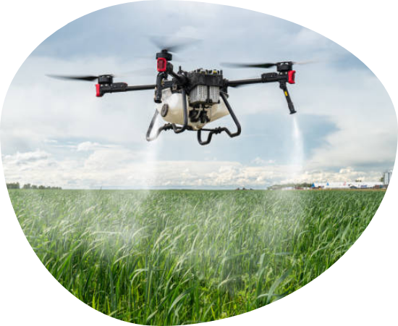
Why Are We Here?
To understand the "Brains" behind modern agricultural machinery.
To bridge the gap between Agriculture and Digital Technology.
To learn how to control the physical world using code.

Slide 3





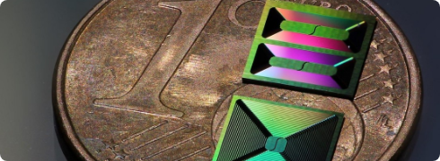
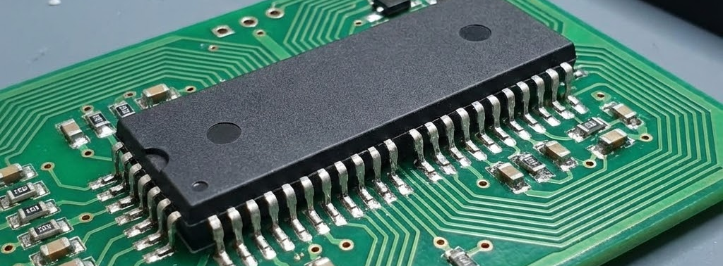
Processor vs. Controller
Microprocessor
Microcontroller
"The Brain in a Jar"
"The Complete Organism"
•
High processing power
•
Self-sufficient System
•
Needs external RAM, ROM
•
CPU + RAM + I/O on one chip
•
Ex: Laptop CPU
•
Ex: Arduino

Slide 4




What is an Embedded System?
"A computing system designed for a specific task within a larger mechanical or electrical system."
Real-Time
Low Power
Reliable

Slide 5

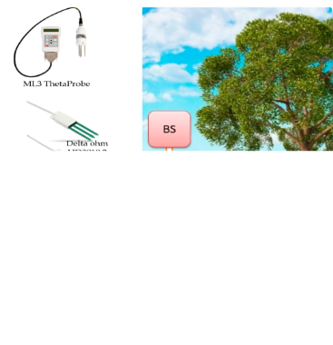
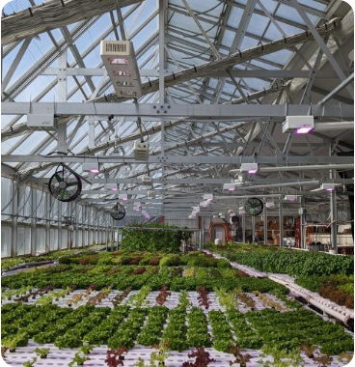
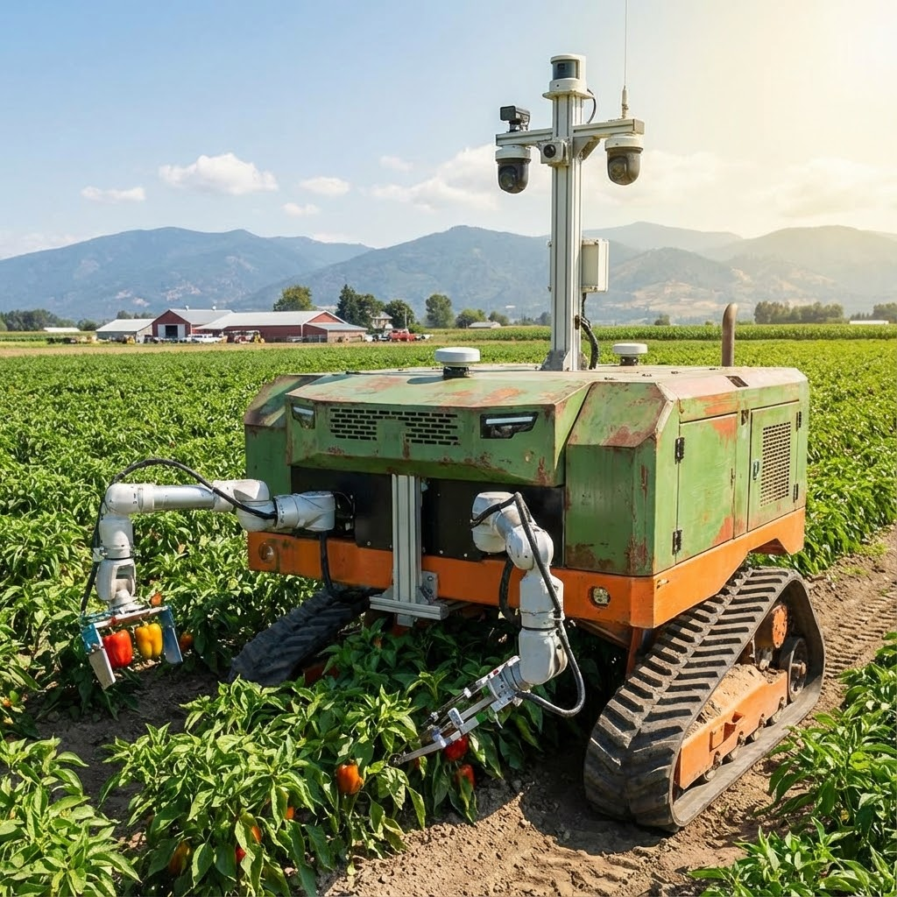



Microcomputers in the Field
Precision Sensing
Smart Greenhouses
Agri-Robotics

Slide 6

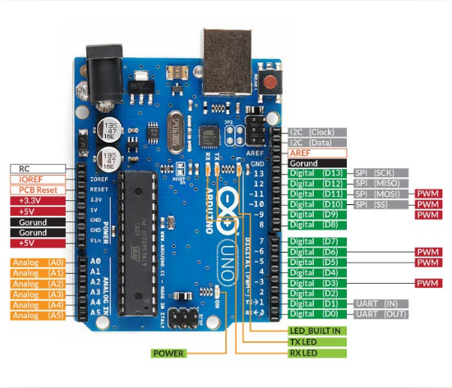

Meet Your Tool: The Arduino
Arduino Uno (ATmega328P)
The world's most popular platform for learning embedded C++.
Why? Open-source, affordable, and perfect for rapid agricultural prototyping.
Digital & Analog I/O
Easy USB Programming
Huge Sensor Ecosystem

Slide 7

Course Roadmap (15 Lectures)
Hardware
Logic
Interfacing
Projects
Fundamentals
& Electronics
C++ Programming
for Arduino
Sensors, Motors
& Displays
IoT & System
Design

Slide 8



Preparation for Lecture 2
Install Arduino IDE
Download the latest version for your laptop.
Review Basic Electronics
Brush up on Ohm's Law (V = IR) and basic circuits.
Come Ready to Dissect!
Next class we analyze the hardware components.

Slide 9



Questions?
"The only stupid question is the one you don't ask."
Dr. Kadeghe Fue
Sokoine University of Agriculture

Slide 10


Image Sources
https://www.sua.ac.tz/sites/default/files/inline-images/sua_logo.png
Source: www.sua.ac.tz
https://media.istockphoto.com/id/2150889998/photo/agriculture-drone-against-background-of-blue-sky-and-green-fields-with-agricultural-plants.jpg?s=612x612&w=0&k=20&c=dlWJdzj29Dim5hvizLeJUY14iPAkFwvoDfX1UAoetjs=
Source: www.istockphoto.com
https://actu.epfl.ch/image/127304/1108x622.jpg
Source: actu.epfl.ch
https://pub.mdpi-res.com/agriculture/agriculture-14-01141/article_deploy/html/images/agriculture-14-01141-g007.png?1721296454
Source: www.mdpi.com
https://www.greenhousegrower.com/wp-content/uploads/2024/08/Climate-smart-farming-of-vegetables-in-a-smart-greenhouse.jpg
Source: www.greenhousegrower.com
https://static.country-guide.ca/wp-content/uploads/2022/01/27101815/2022_January_-Robotics_set_to_revolutionize_farm_operations_-Naio_Oz_-DSC_1376.jpeg
Source: www.country-guide.ca

